Slide 1
Uno with Q-learning
Project by
Sebastian Bielfeldt (Mtr: 6400507)
Marco Knipfer (Mtr.: 4640754)
Nils Nover (Mtr.: 6983668)
Roman Smit (Mtr.: 4497101)

Slide 2
Agenda
The Game
The Setup
(Planned) Reinforcement Agent
Outlook
Demo

Slide 3
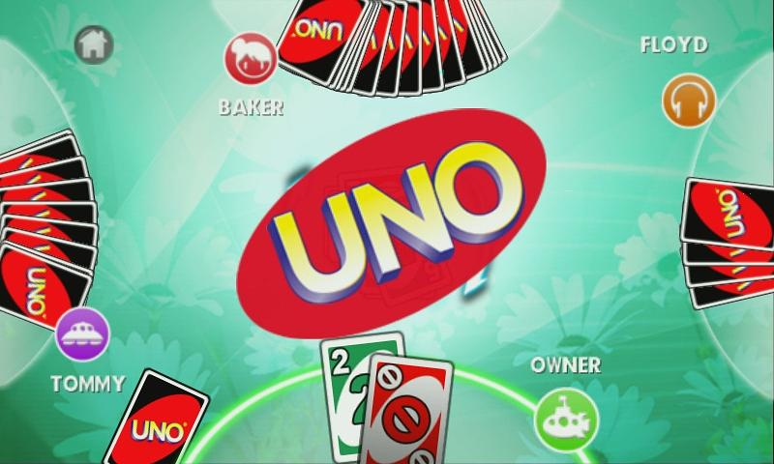
Simplified Uno (for now)
  Two players
  4 Colors, 10 Numbers and Draw 2 and Change Directions
Notes:
Quickly explain rules
explain different strategies:
holding “wish cards”
holding +2 cards
battle in the end

Slide 4
Perks and challenges Using Q-learning
Set up game engine, arena, agents
Q-table not feasible
Neural network
Randomness
Reinforcement learning strategy
Notes:
API for Agent
NN: function approximator
pytorch
Randomness: Opponent, draw cards

Slide 5
Setup
Uno
Engine
Arena
Agent 2
Agent 1

Slide 6
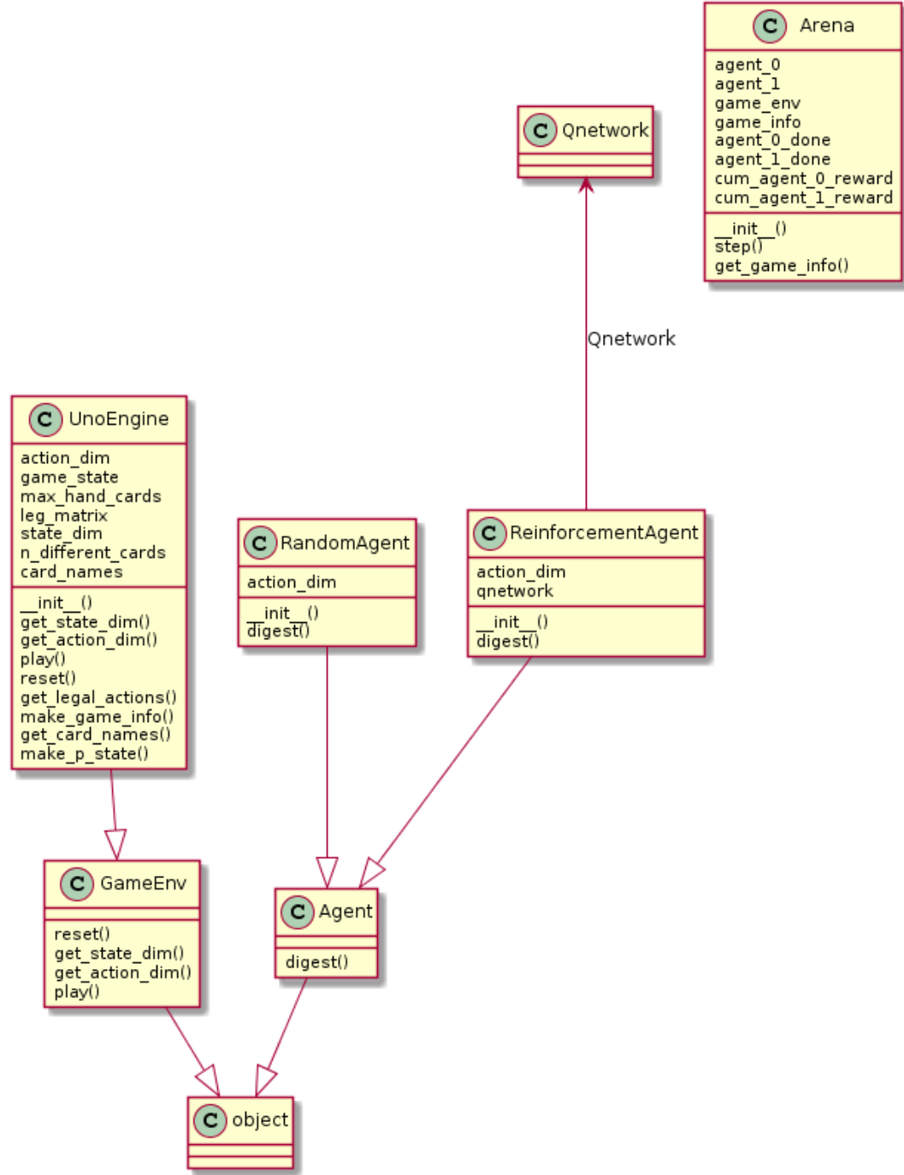
Setup
Arena
Uno Engine
Agent

Slide 7
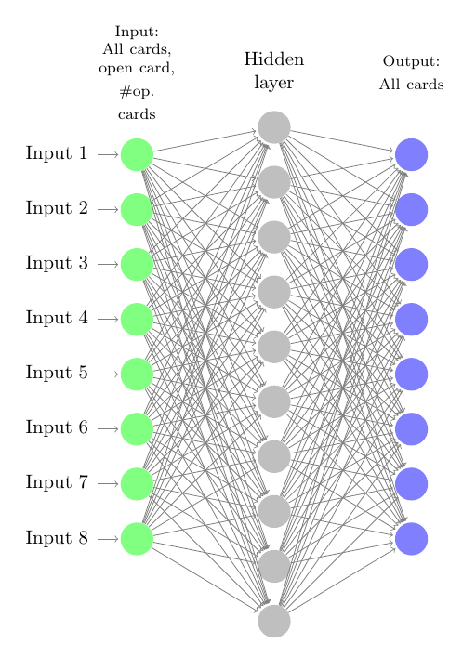
{
all possible cards
1
0
0
2
1
0
Open card
# of opponents hand cards

Slide 8
Status quo and outlook on this Project
Uno engine, arena, random agent: Working
Simple toy example neural networks: Working
Reinforcement agent: Not implemented
Notes:
Good documentation in code for engine, arena, agent
Neural network: openaigym games like frozenlake
For reinforcement agent: Need neural network
Write documentation of project

Slide 9
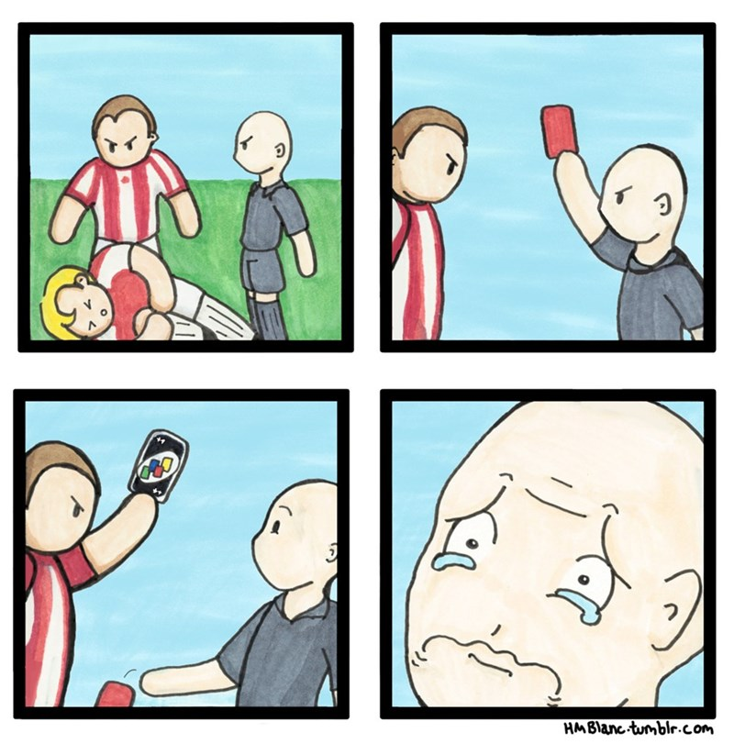
Thank you for your attention!

